Slide 1
StudyMatch - Academic Companion
Finder(Mobile app)
Presented by:
Nafisa Tabassum (1804066)
Riad Hossain (1804071)
Ariful Islam Shakil (1804072)
Supervised by:
Mir MD Saki Kowsar
Assistant professor, Dept. of CSE.
Moumita Sen Sarma
Lecturer, Dept. of CSE.

Slide 2
Contents
Introductions
Objectives
Features
Tools & Technology
Component design
GUI
Database
Conclusions

Slide 3
Introduction
"StudyMatch" – an Ideal Academic Companion Finder
Simplifies connecting with the right study partner in academia
Set up academic profile, explore like-minded peers
Connect based on shared subjects and study preferences
Dive into academic interests using hashtags
Join or create study groups effortlessly

Slide 4
Objectives
Connect with compatible study partners
Share academic interests through hashtags
Establish study groups for collaborative learning

Slide 5
Features
Profile-based Matching
Create profiles with academic interests and preferences
Find study partners that align with your needs
Hashtag-based Interests
Categorize academic interests with hashtags
Follow and search for subjects that match your passion

Slide 6
Tools & Technology
Frontend - Flutter
Backend - Supabase
Database – PostgreSQL
IDE- VsCode
Version Control- GitHub

Slide 7
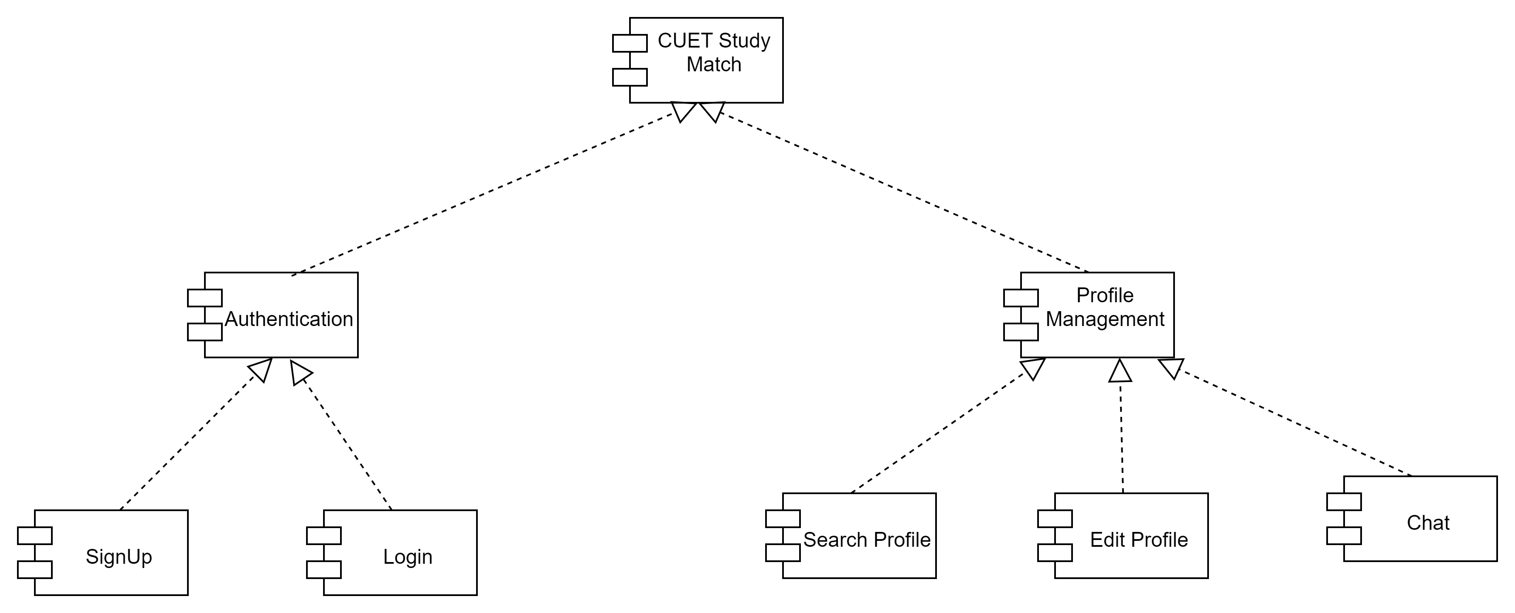
Component Design
Figure - 01: Structure Chart of CUET Study Match System

Slide 8
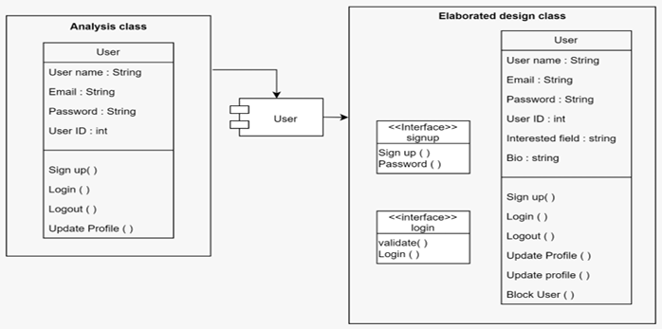
Component Design (Cont.)
Figure - 02: Component Design for User Management

Slide 9
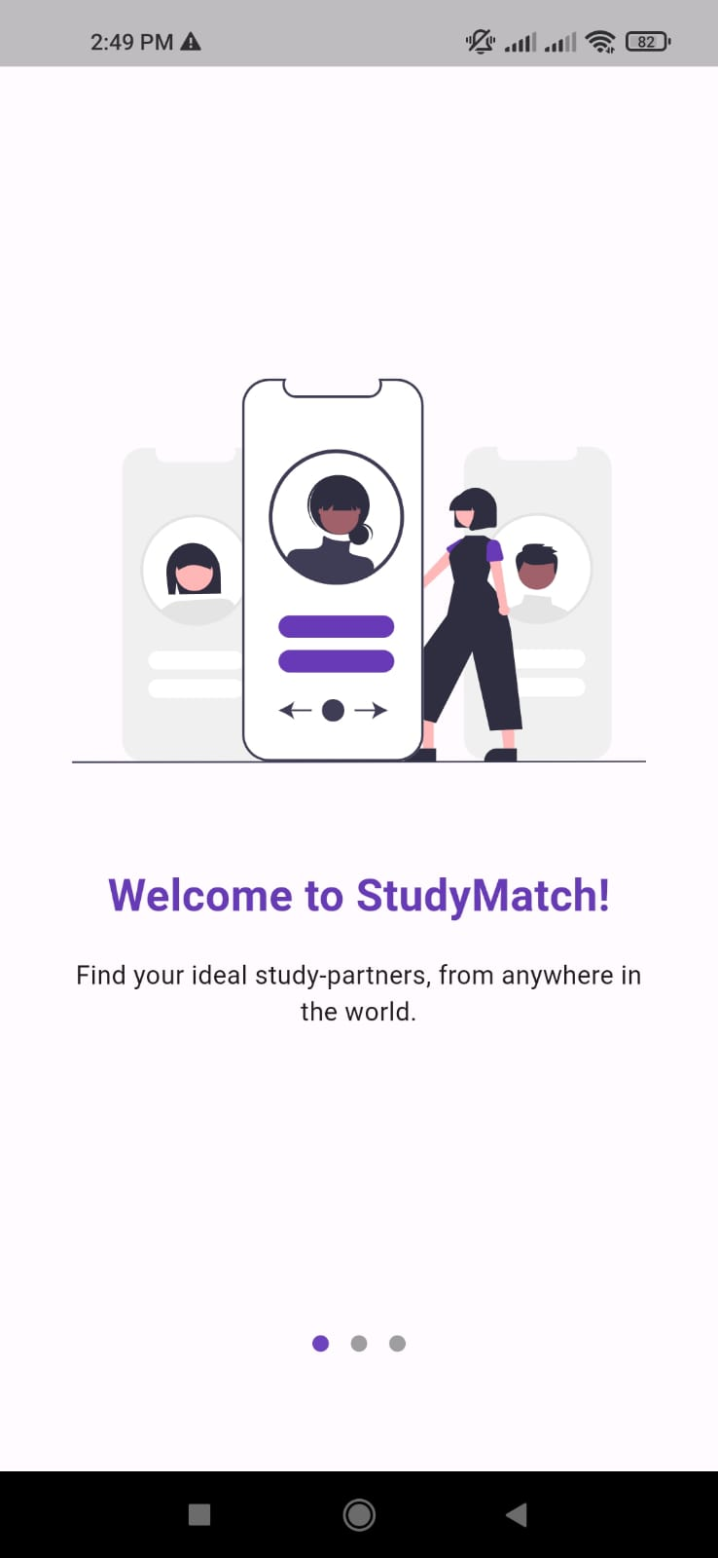
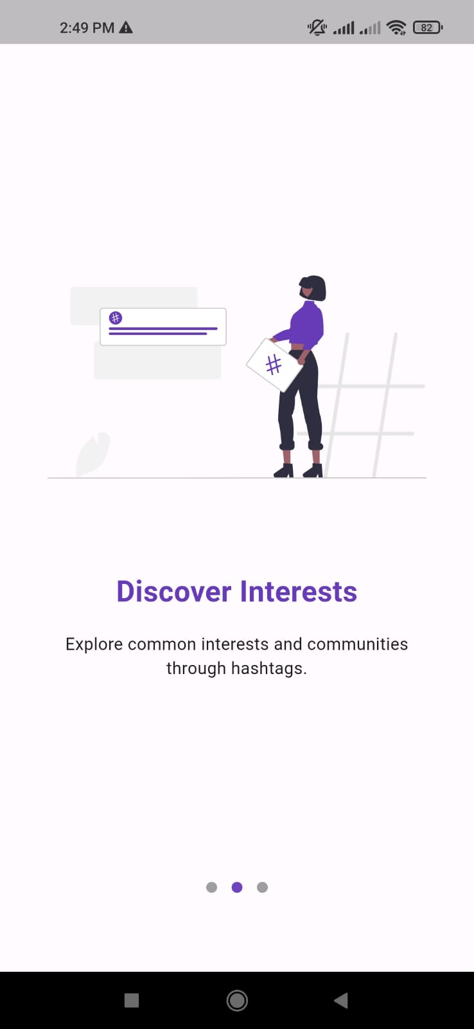
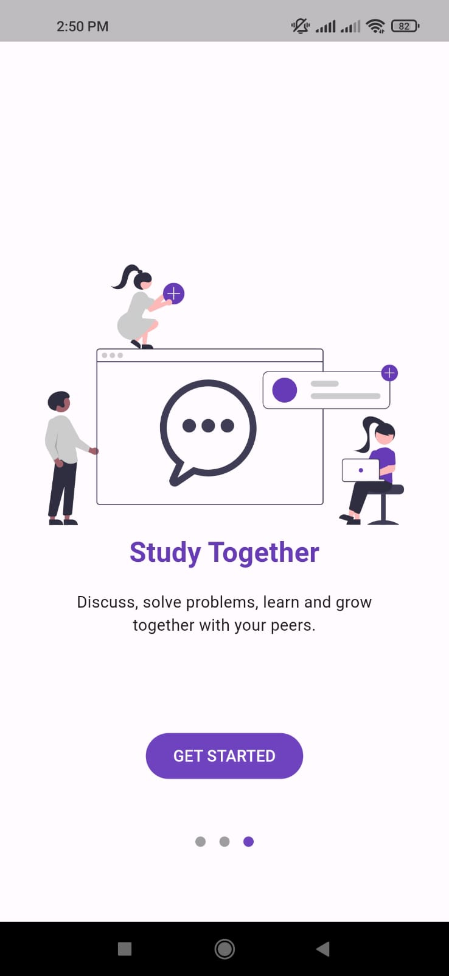
GUI
Figure 03: Welcome screen

Slide 10
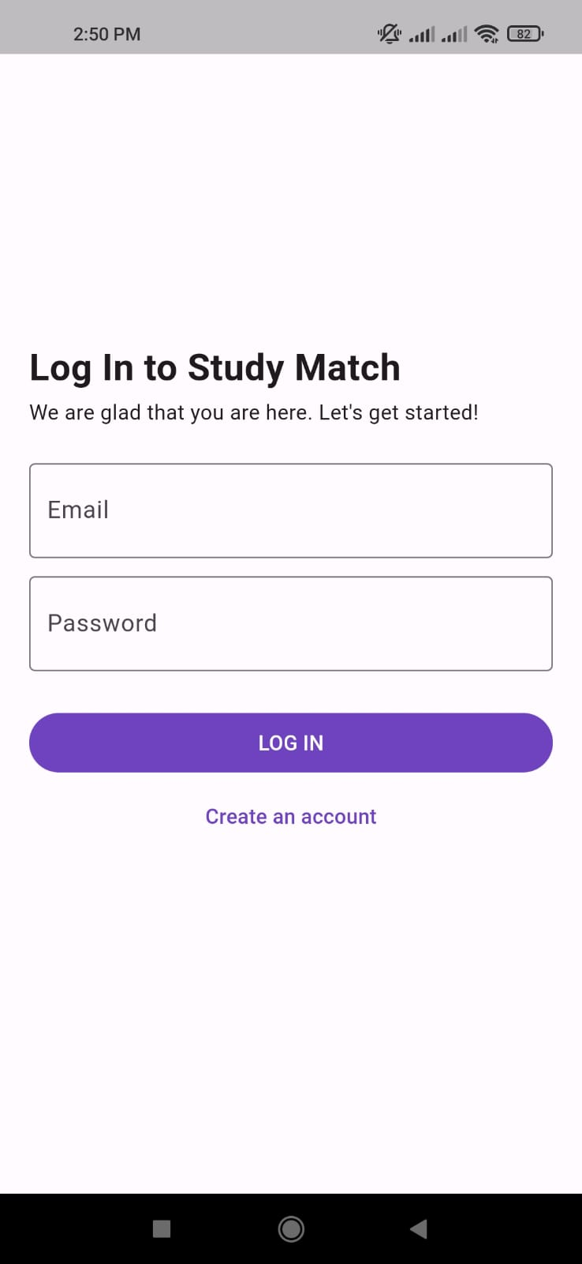
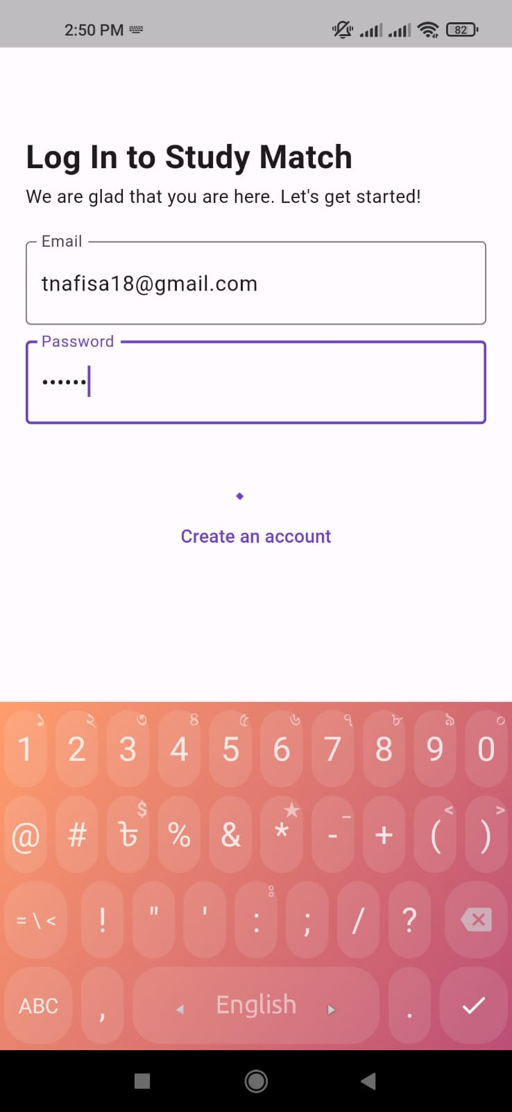
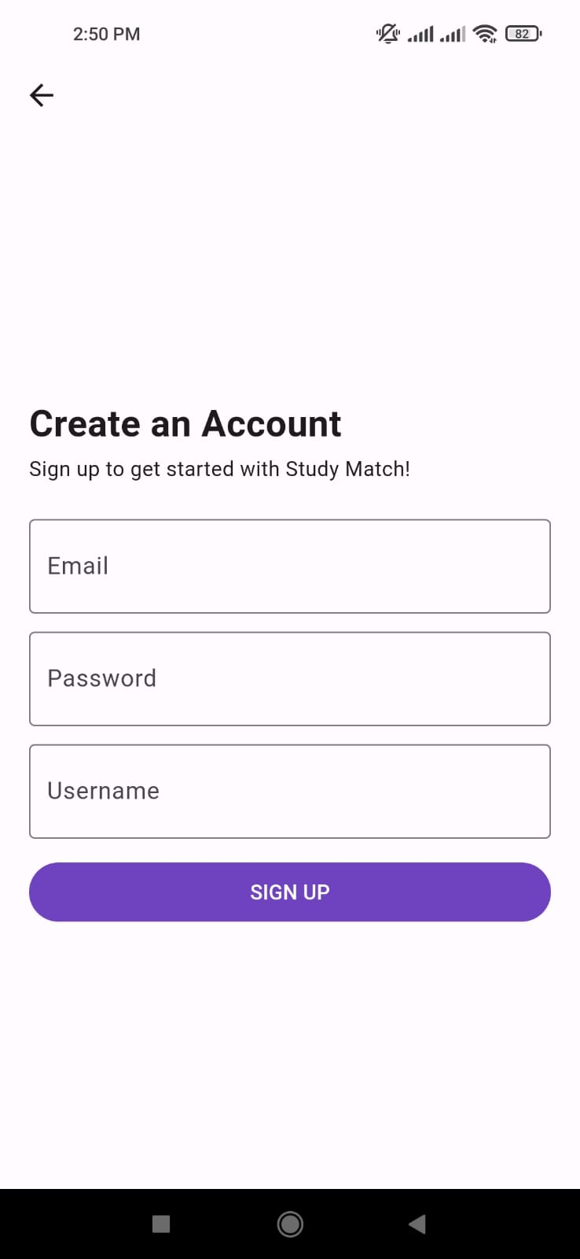
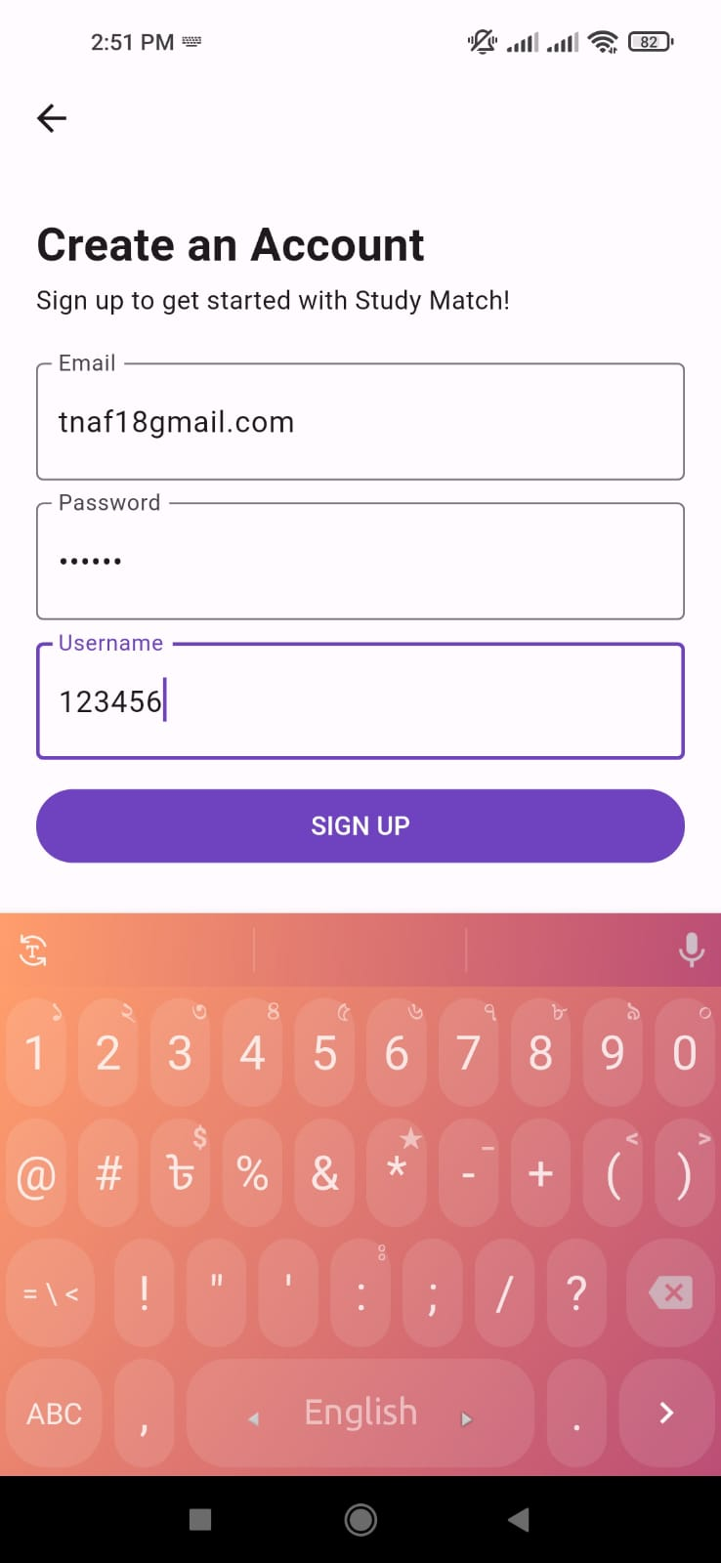
GUI (cont.)
Figure 04: Log In and Sign Up screens

Slide 11
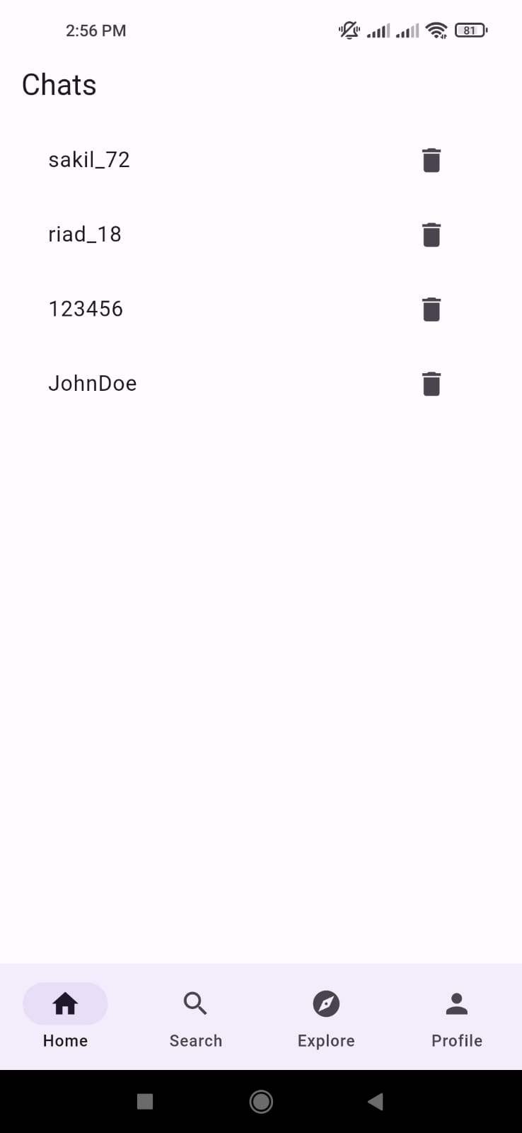
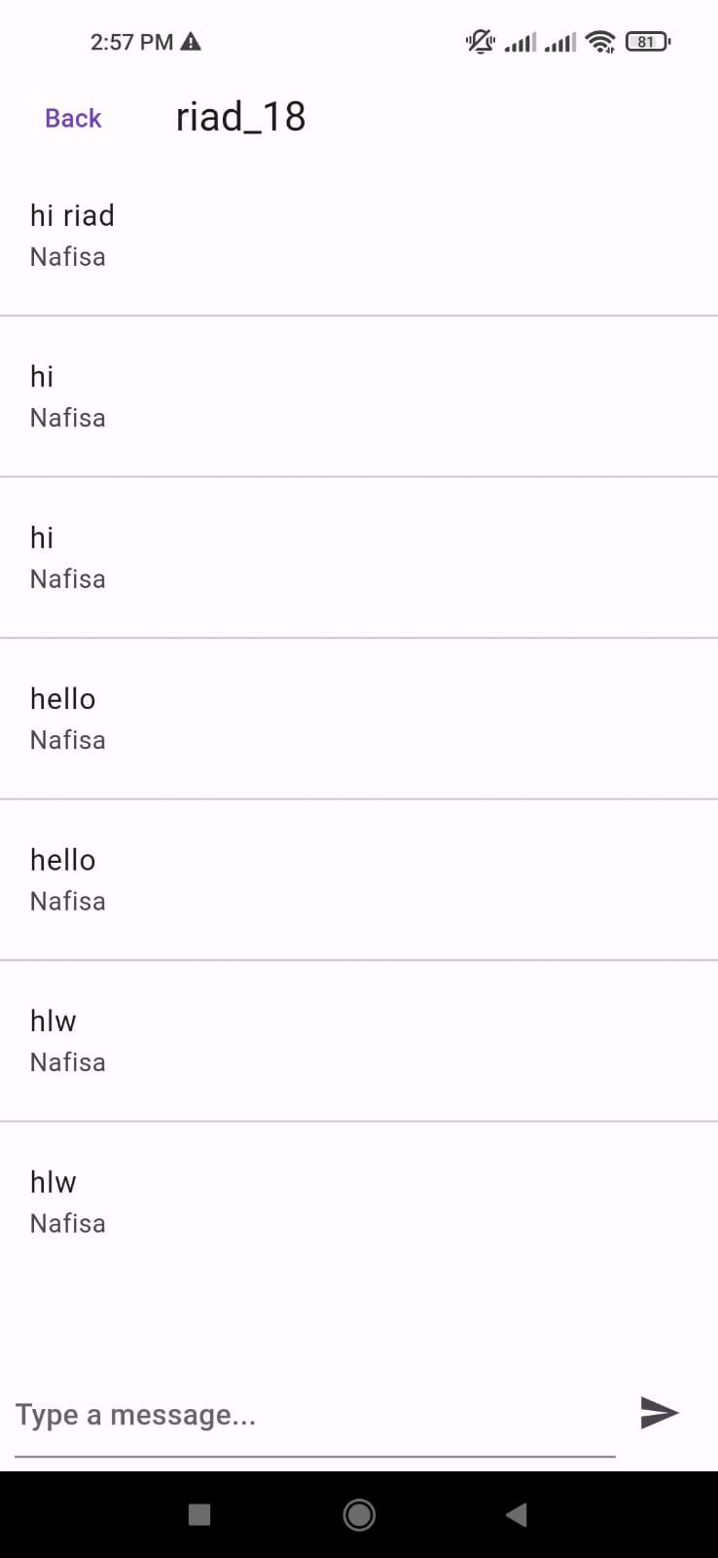
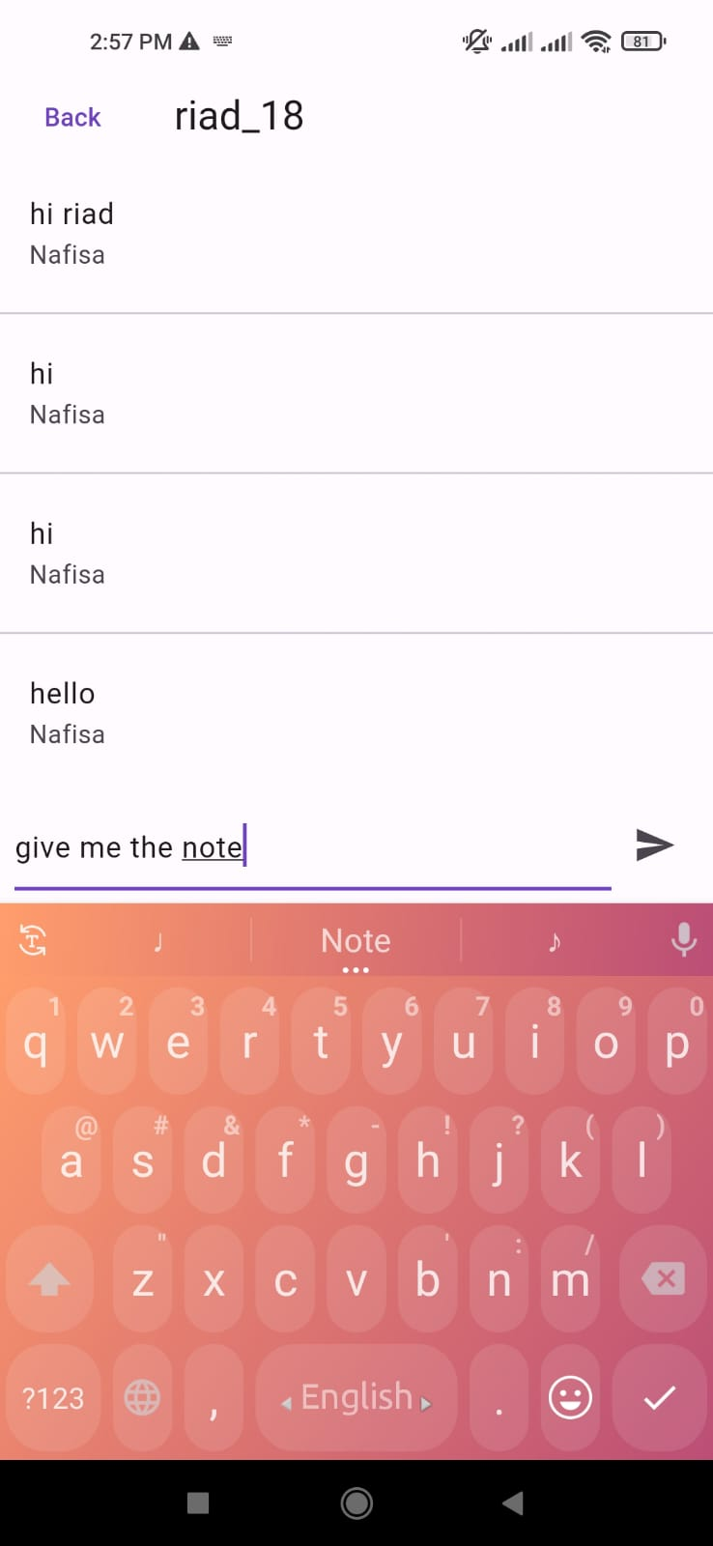
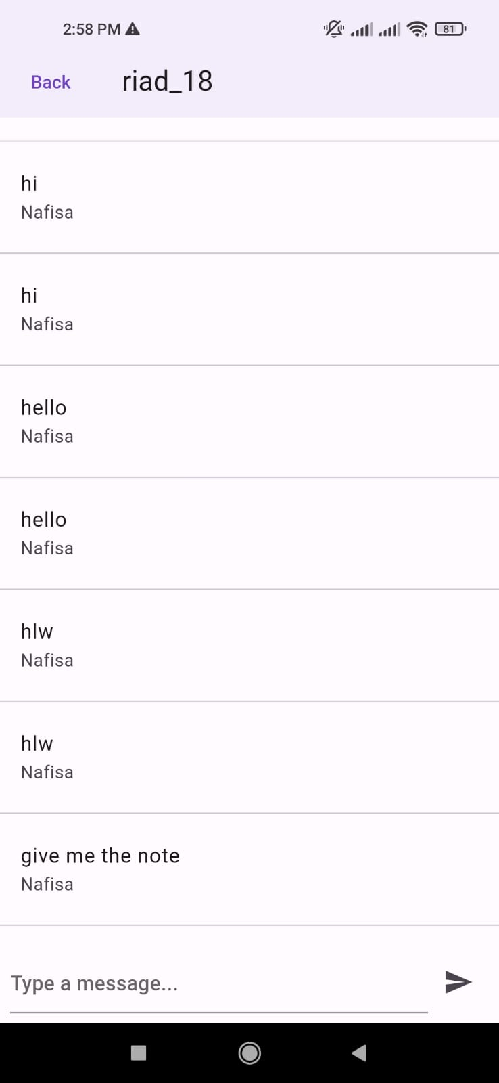
GUI (cont.)
Figure 05: Chat screen

Slide 12
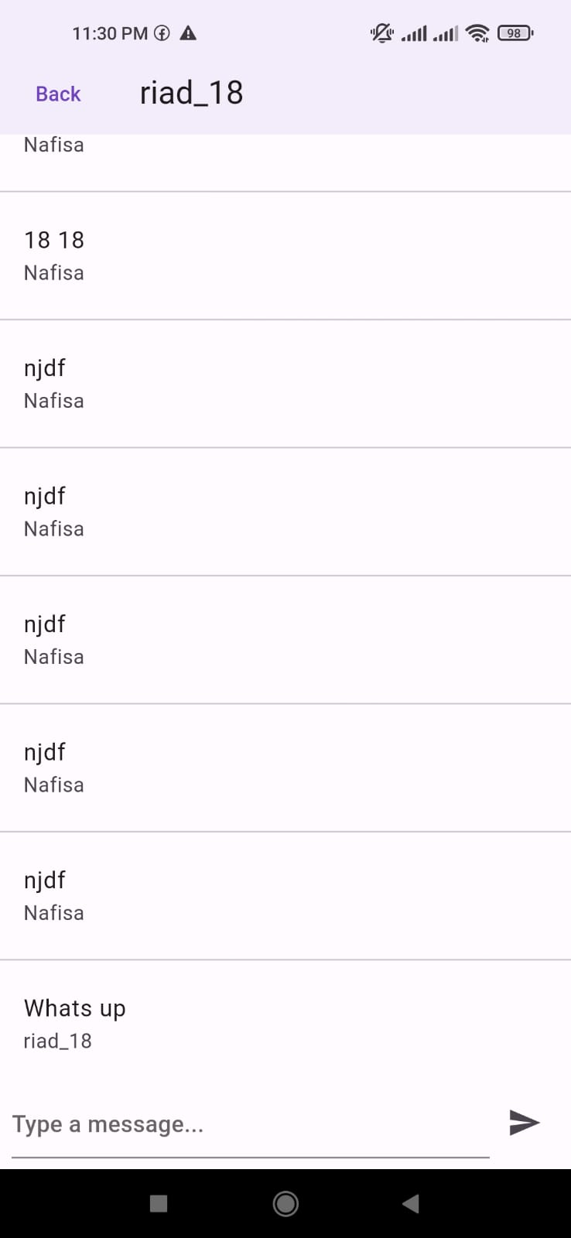
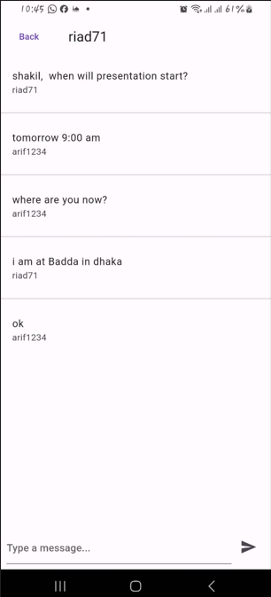
GUI (cont.)
Figure 06: Chat screen (receiving message)

Slide 13
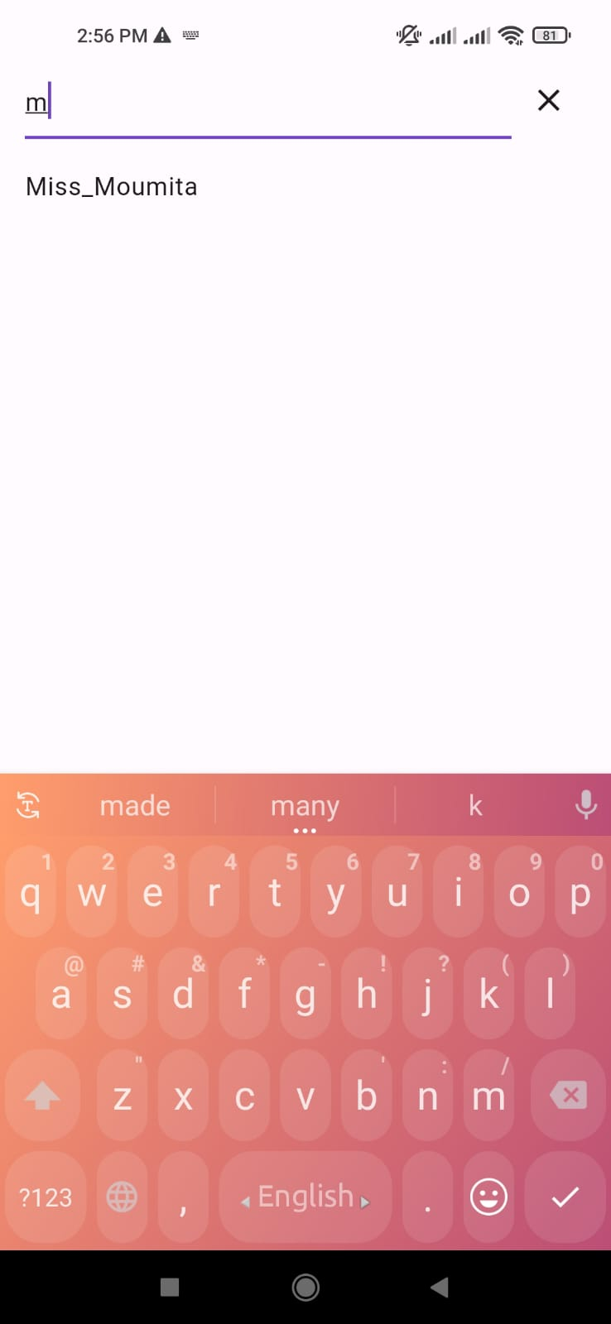
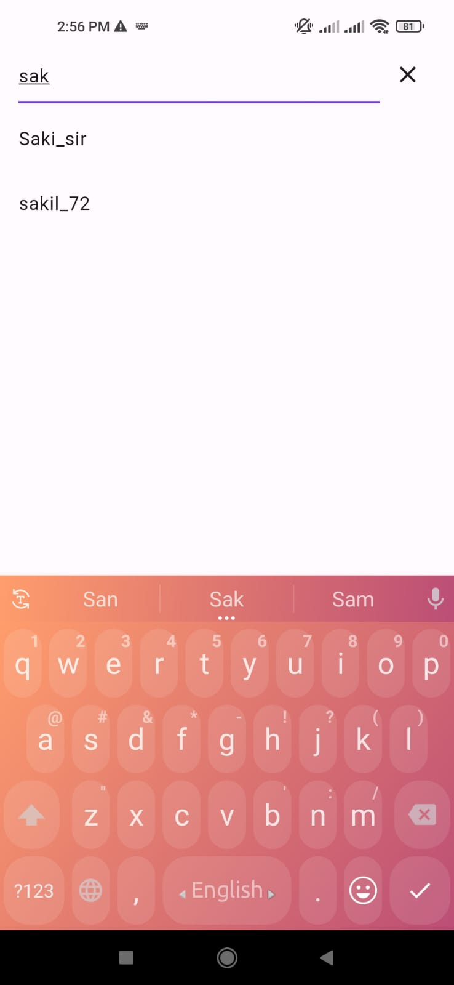
GUI (cont.)
Figure 07: Search screen

Slide 14
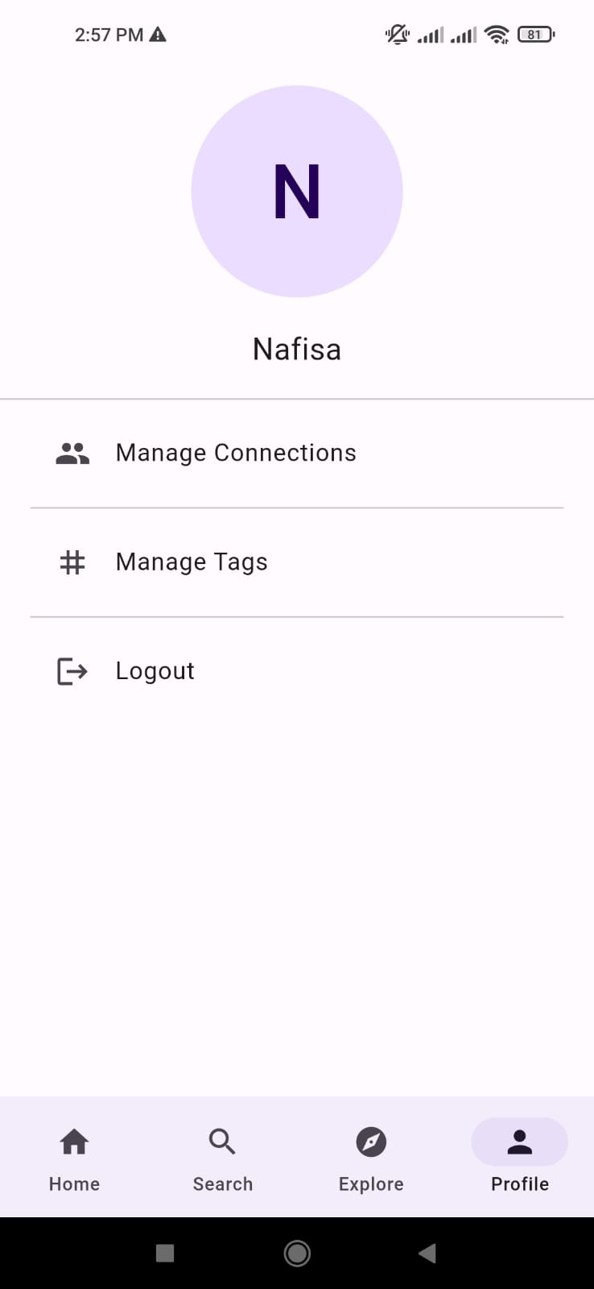
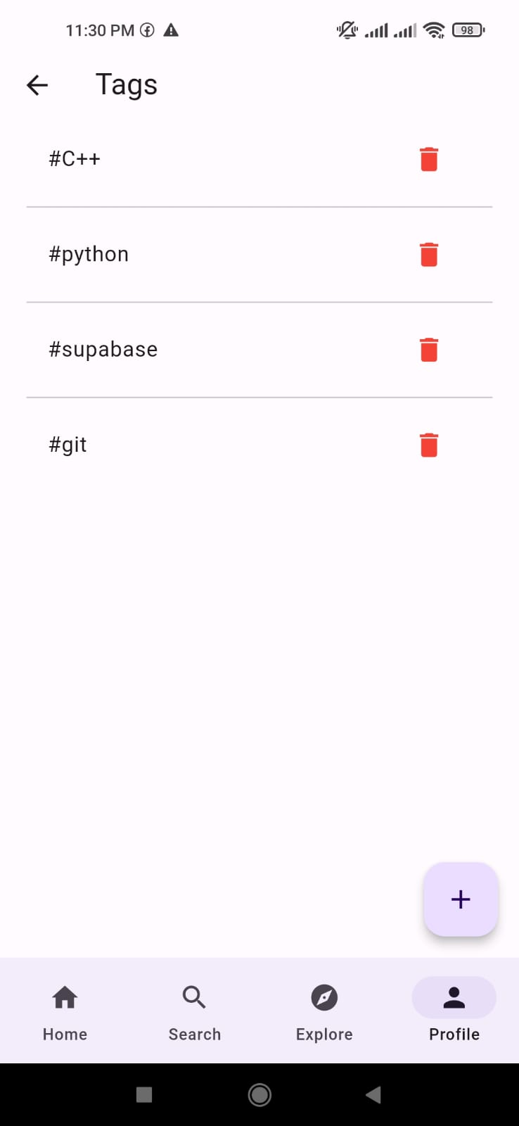
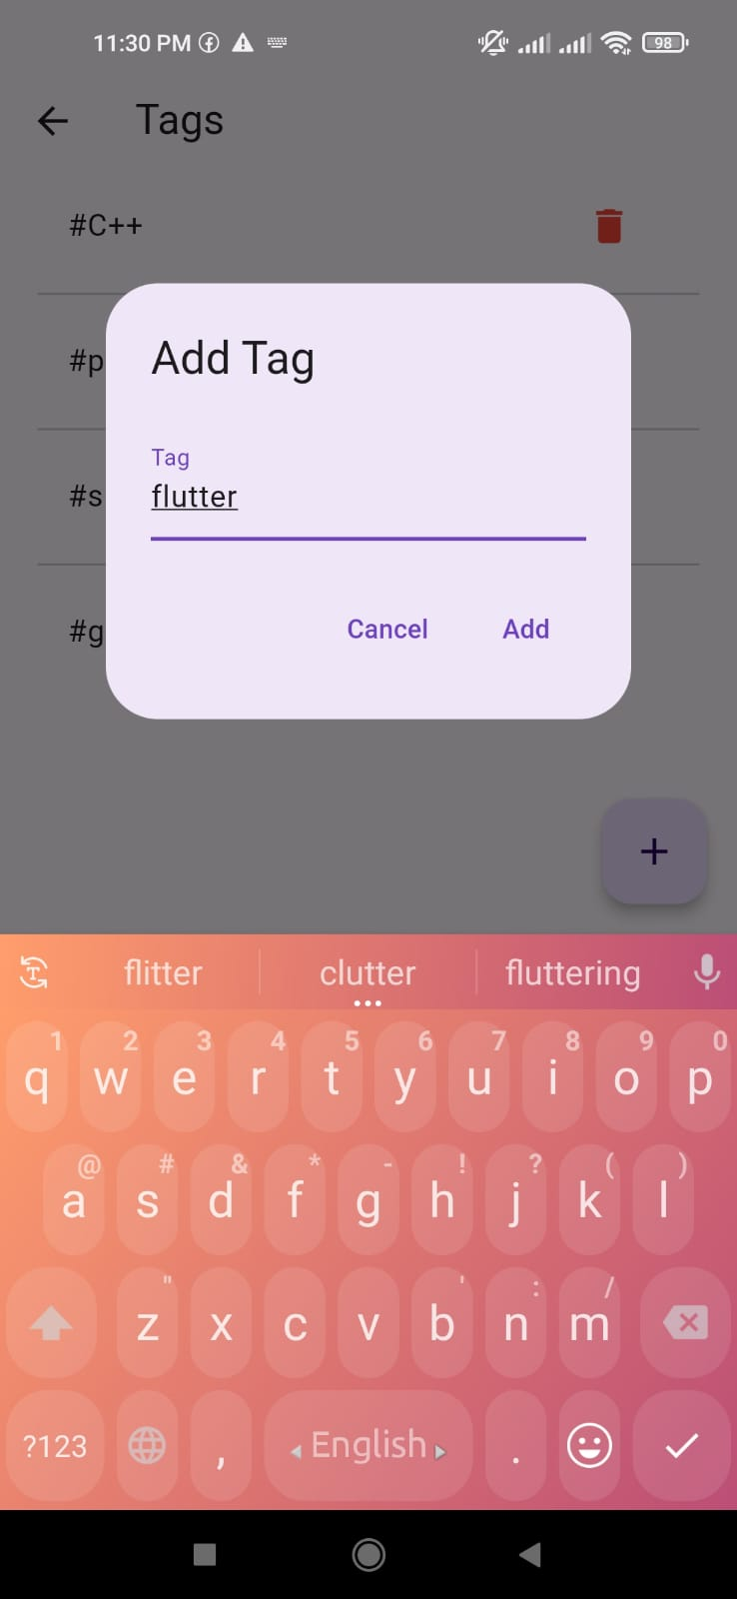
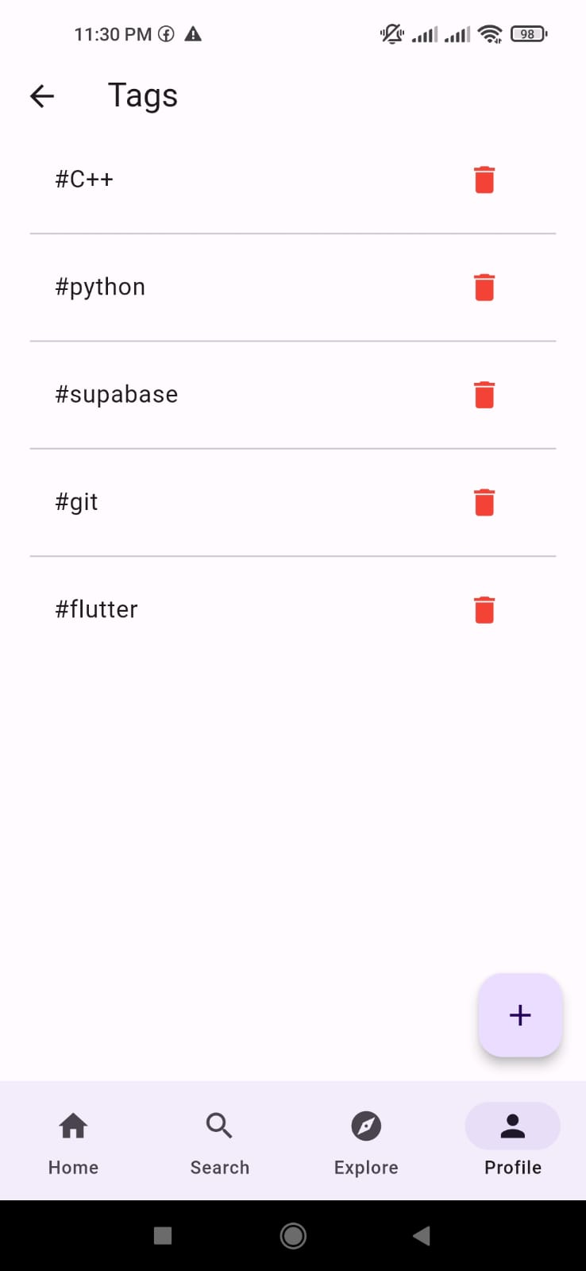
GUI (cont.)
Figure 08: Profile tab and Tags management screen

Slide 15
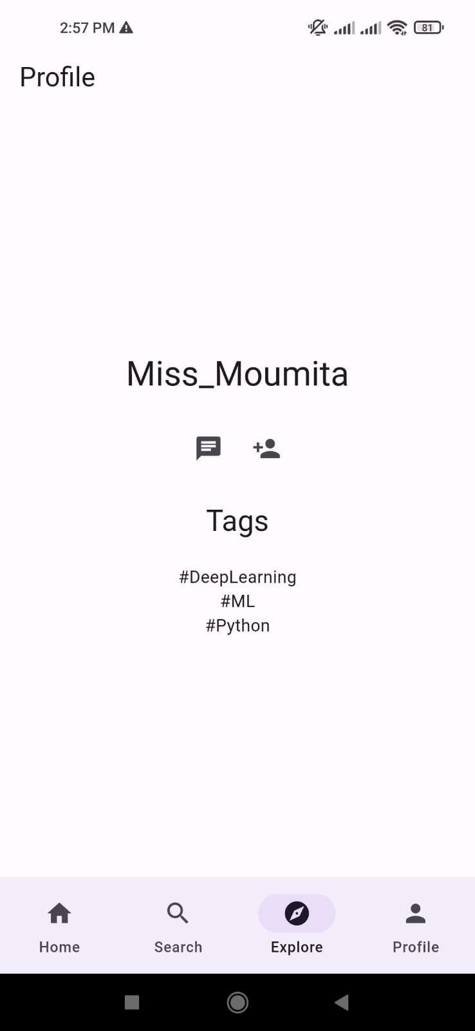
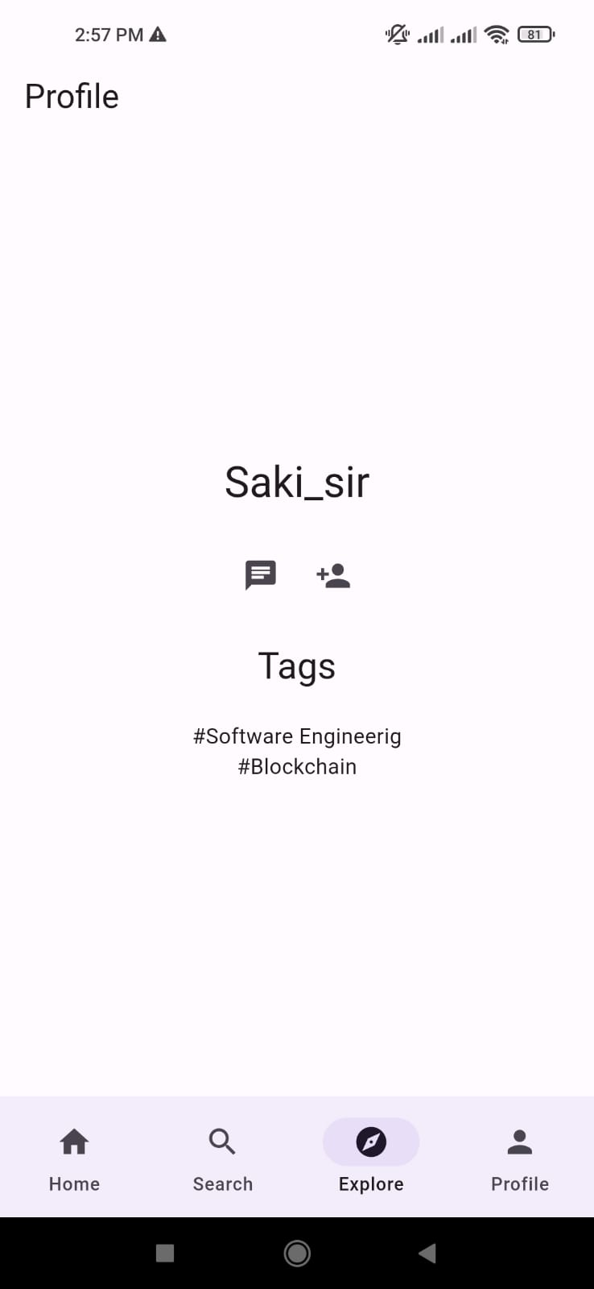
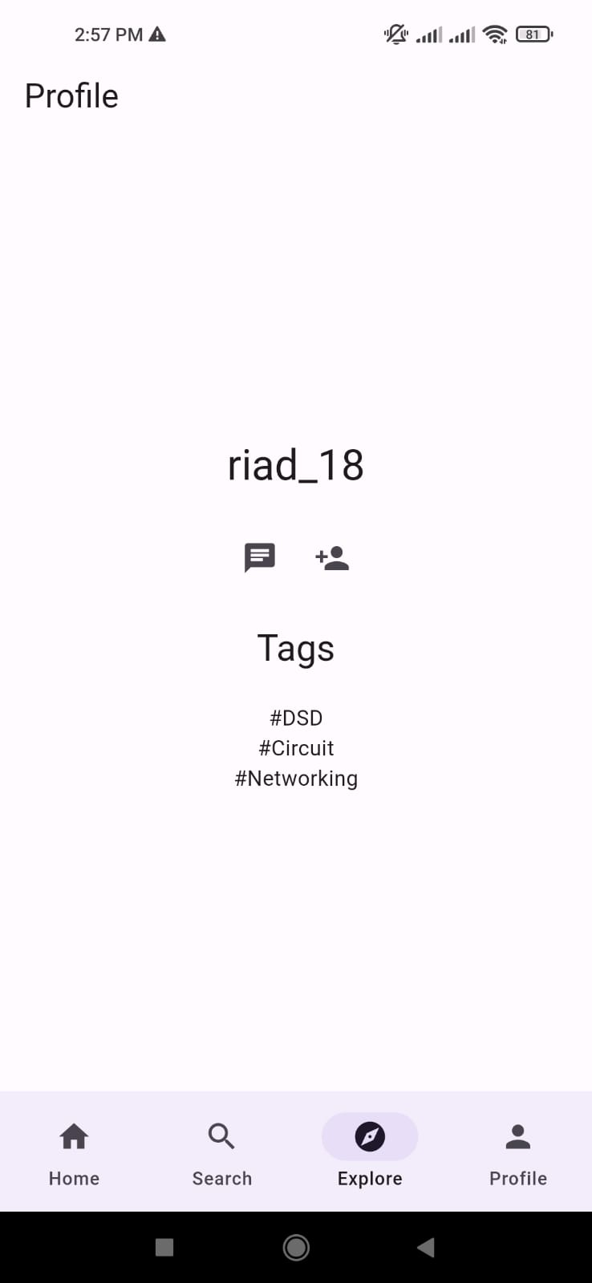
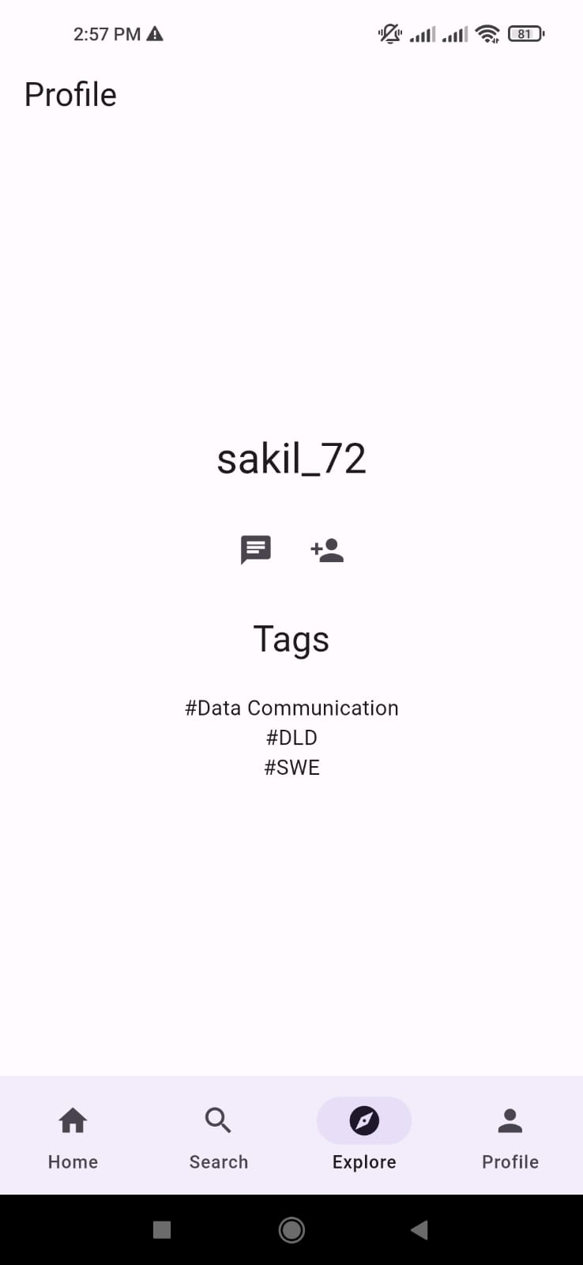
GUI (cont.)
Figure 09: Explore Tab with profiles suggestions

Slide 16
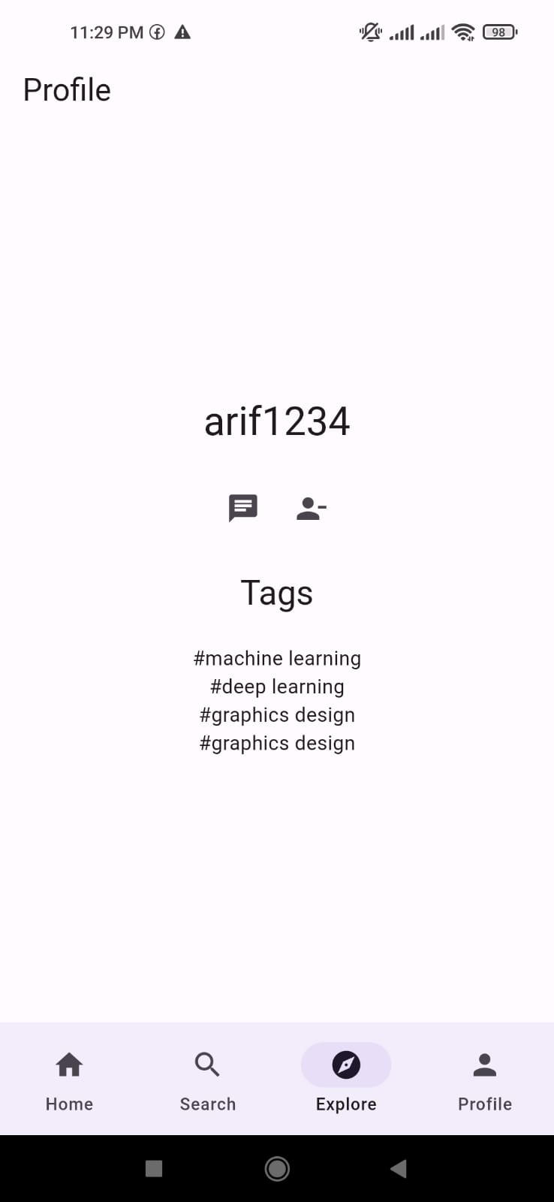
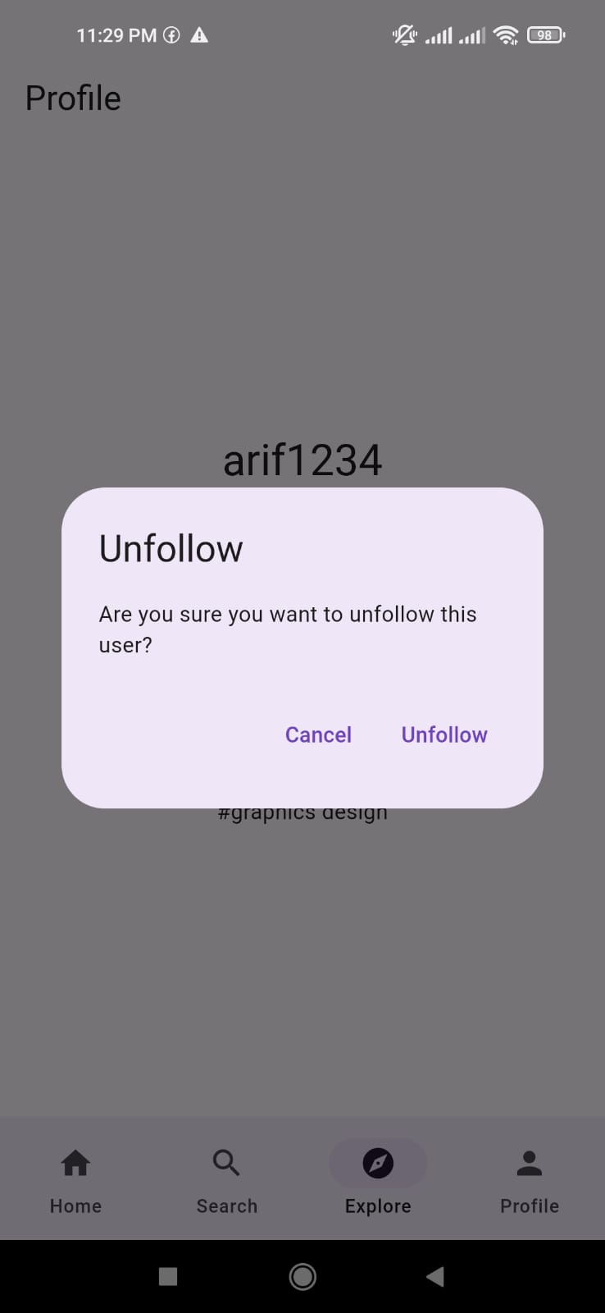
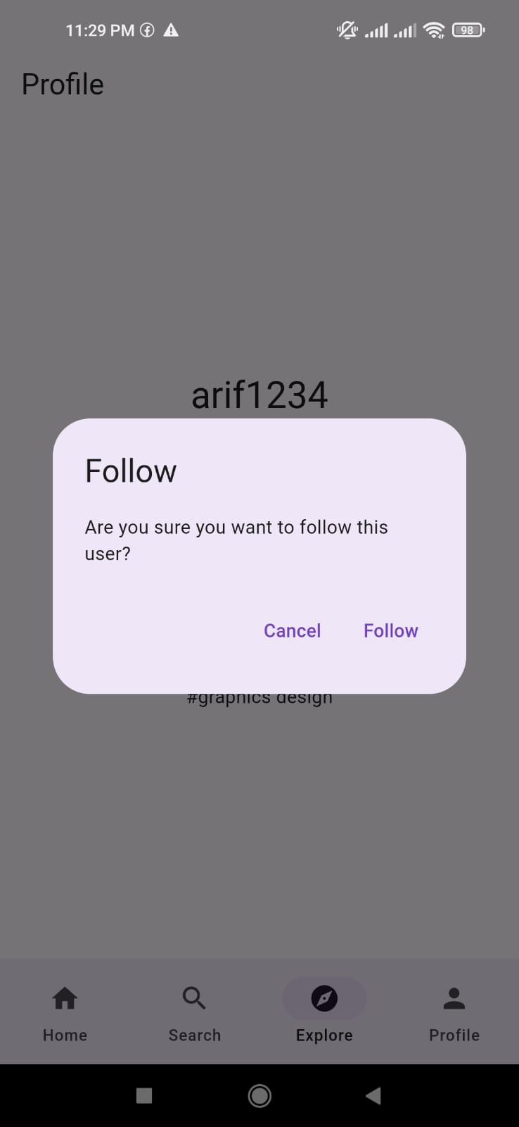
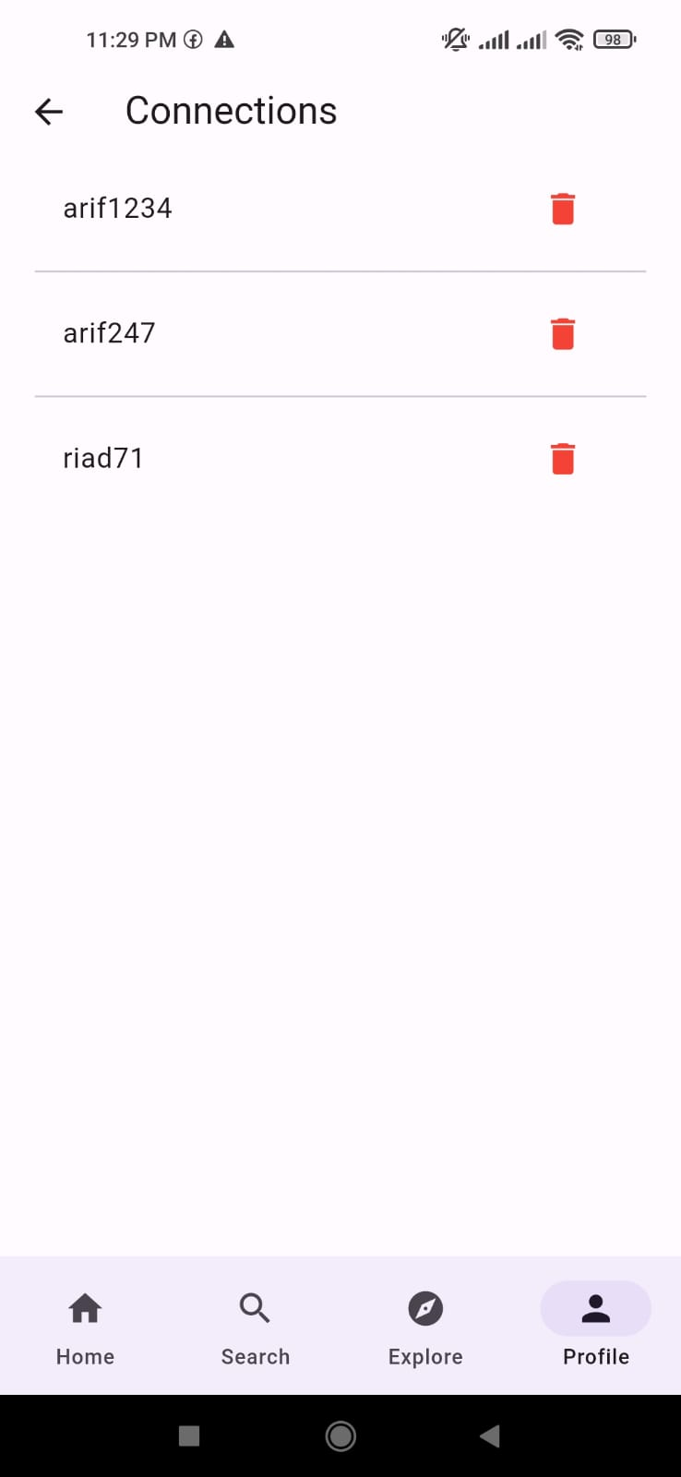
GUI (cont.)
Figure 10: Follow/unfollow profile

Slide 17
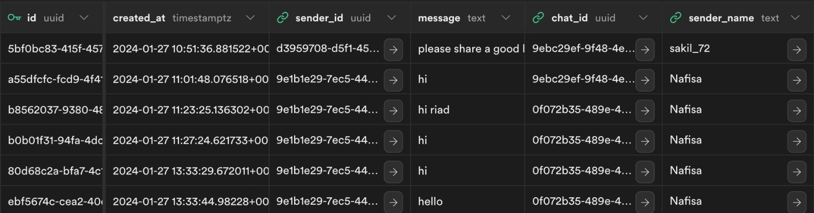
Database
Figure 11: chat_messages Table

Slide 18
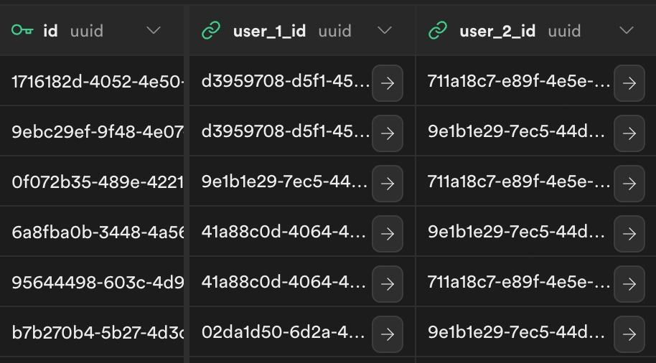
Database (cont.)
Figure 12: chat Table

Slide 19
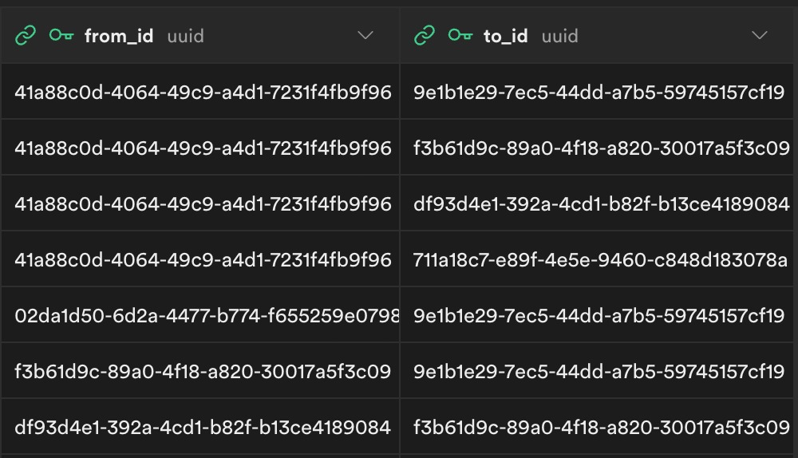
Database (cont.)
Figure 13: connections Table

Slide 20
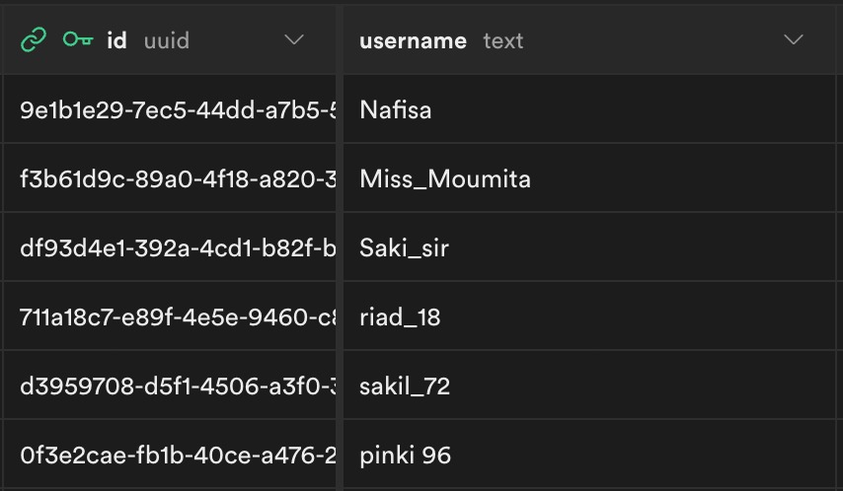
Database (cont.)
Figure 14: profiles Table

Slide 21
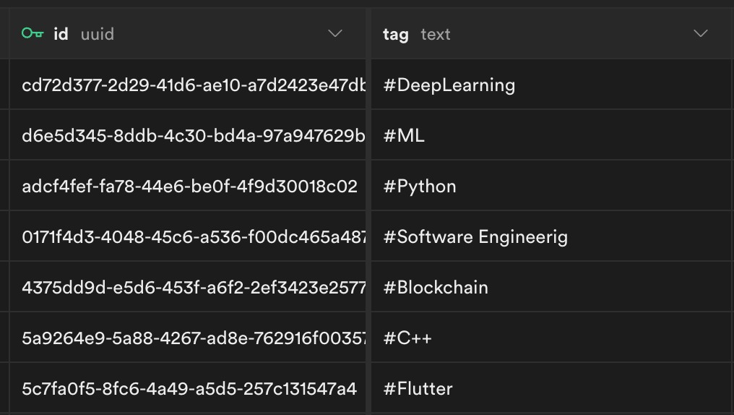
Database (cont.)
Figure 15: tags Table

Slide 22
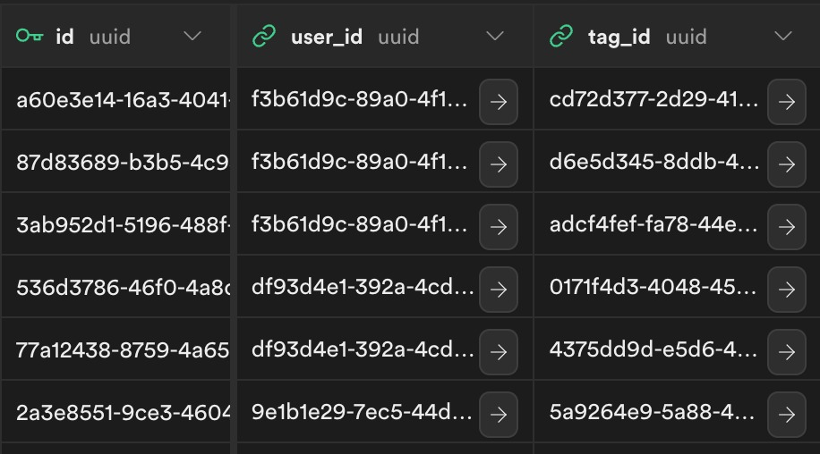
Database (cont.)
Figure 16: user_tags Table

Slide 23
Conclusion
StudyMatch enhances the academic journey
Find study partners easily
Connect with like-minded peers
Foster collaborative learning
Promotes knowledge sharing and meaningful academic connections

Slide 24


